Slide 1

REAL ESTATE
Sprint 1&2
BY:
SUPRIYA BARTHWAL

Slide 2
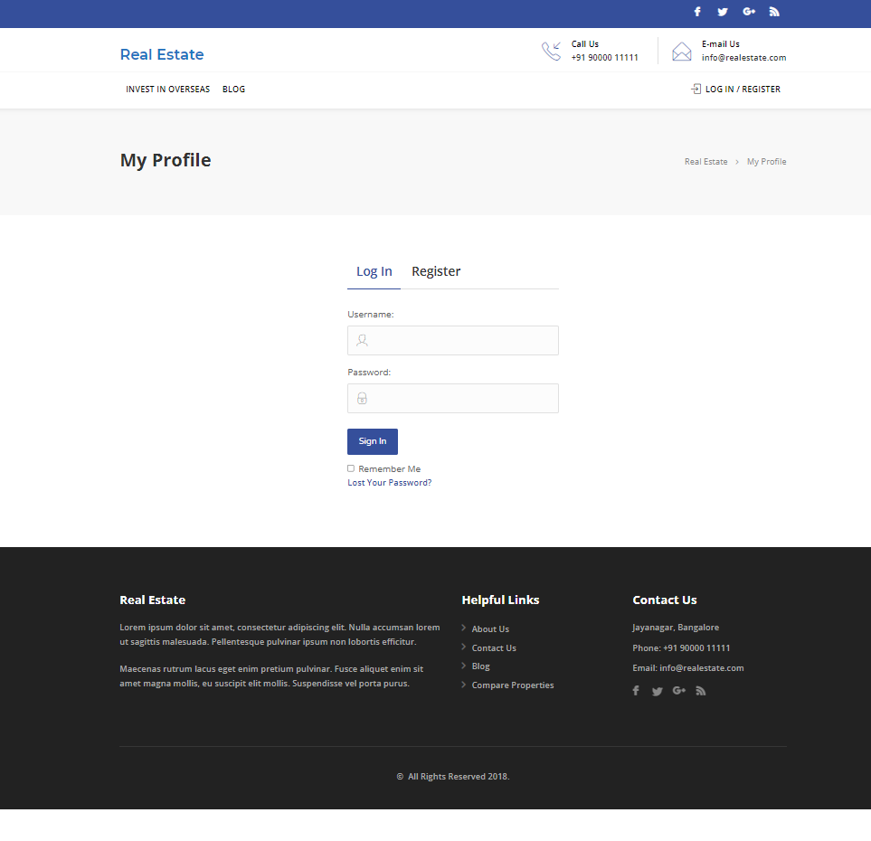
Real Estate website
Welcome to Real Estate

Slide 3
FEATURES
Admin
Login
Profile
Dashboard
Comments
user-all, new, profile
Post-all post
Media-library, add new
property-add new
User
Register/Login
Homepage
Profile
Property management-contact form
Search property
Bookmark
For enquires
Change password

Slide 4
Manual testing - sprint 1
Activities
Planning-User stories in Jira
Work allocation- For test design to team members- Jira tasks
Test design process-
Scenarios- categorised based on business risks
Test cases
Pre-conditions and specification for data creation
Test design techniques applied where ever necessary
Review process and baseline of testcases

Slide 5
Jira – Workflow in Sprint 1
15 Stories were created in Jira with respect to Admin side and user side
No of tasks & sub-tasks-16
No of bugs - 23
Review of each task was completed.
Execution of the testcase was submitted.
Defects were logged into the defect log with 23 defects.
Issue log was created with 41 issues.

Slide 6
Test Metrics
Module wise number Of test cases written-100
Defect age
Category wise defect analysis based on priority, severity, status -41
Review of each task and submission of checklist.
Execution of the testcase was submitted.

Slide 7
Automation testing - Sprint 2
Planning activities-selection of test cases for automation under
Smoke test
Sanity test
Regression test
Task allocation for automation test cases to automation testers
Techniques followed - Selenium , Java ,Maven, TestNG, Page Object Model, frameworks selected for the automation

Slide 8
SPRINT 1
User Home Page, Admin All User and Admin Add New User form functionalities were assigned by scrum master
Stories and task for user homepage and admin user were created in Jira
Test cases for user homepage and admin user functionalities were created in excel
Test cases were reviewed and executed
Defects and issues which were found during the execution of test cases and were noted down
Bugs were created in Jira

Slide 9
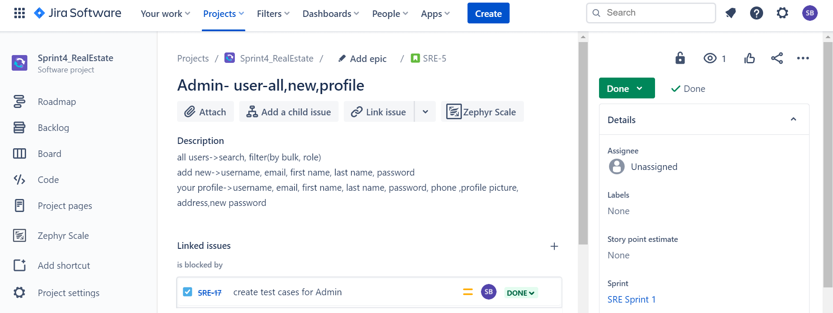
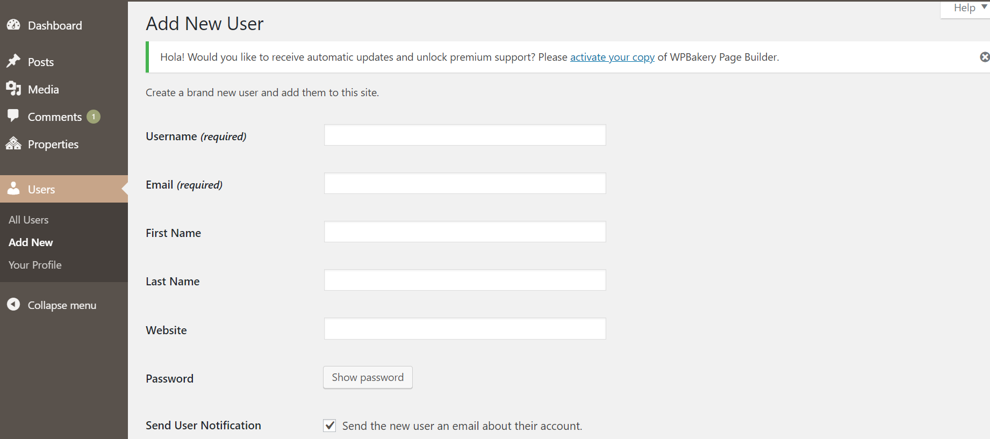
SPRINT 1
Fig. Snapshot from Jira
Fig. Snapshot of website

Slide 10
SPRINT 2
SMOKE TEST
For Functionality: User Homepage
Using: Selenium IDE
SANITY TEST
For Functionality: Admin All Users
Using: Selenium Webdriver
REGRESSION TEST
For Functionality: Admin Add New User
Using: Selenium Webdriver
The above mentioned functionalities were automated using eclipse
Automation tools namely Selenium, Java, Maven, TestNG were used
TestNG reports were generated

Slide 11
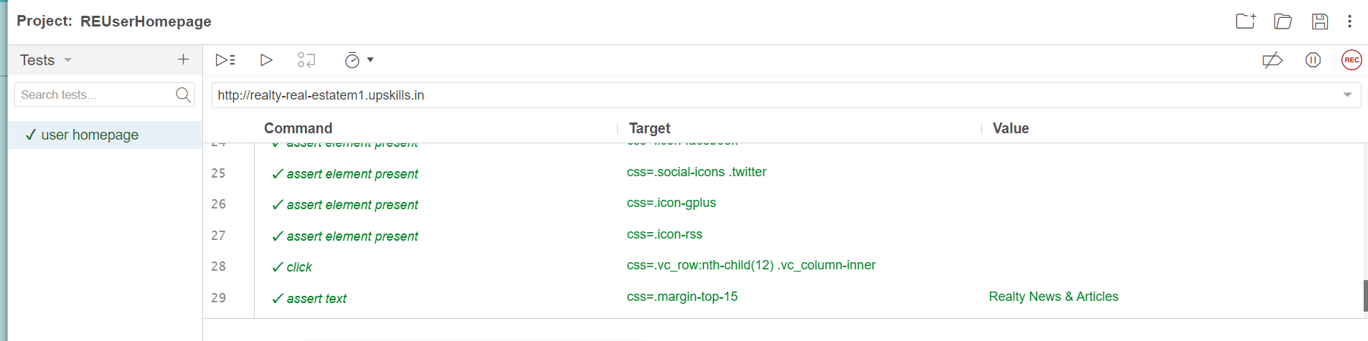
SPRINT 2 Smoke Test
Fig. Selenium IDE environment

Slide 12
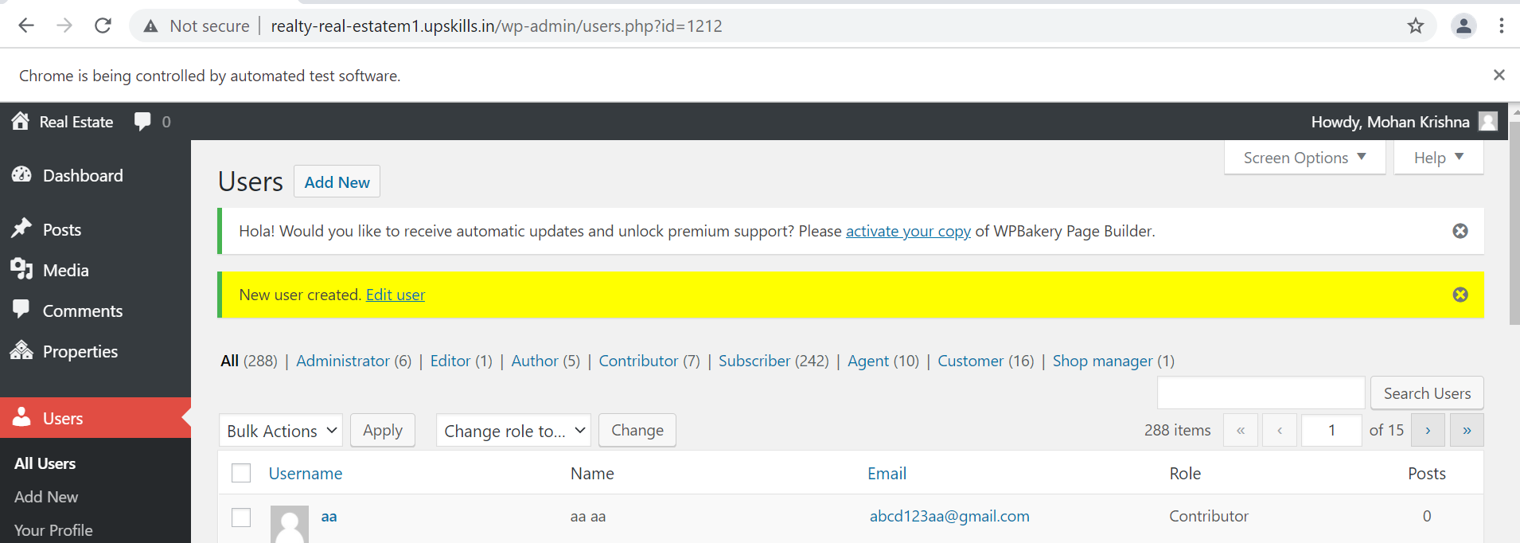
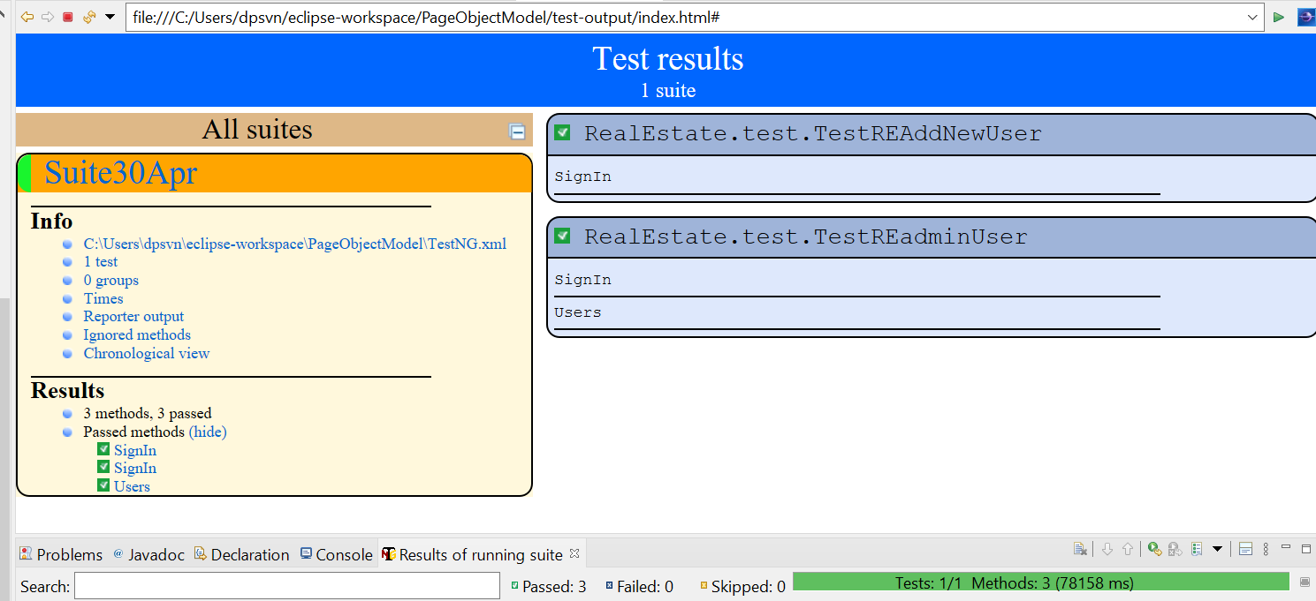
SPRINT 2 Sanity & Regression
Browser being controlled by Selenium:
TestNG report:

Slide 13
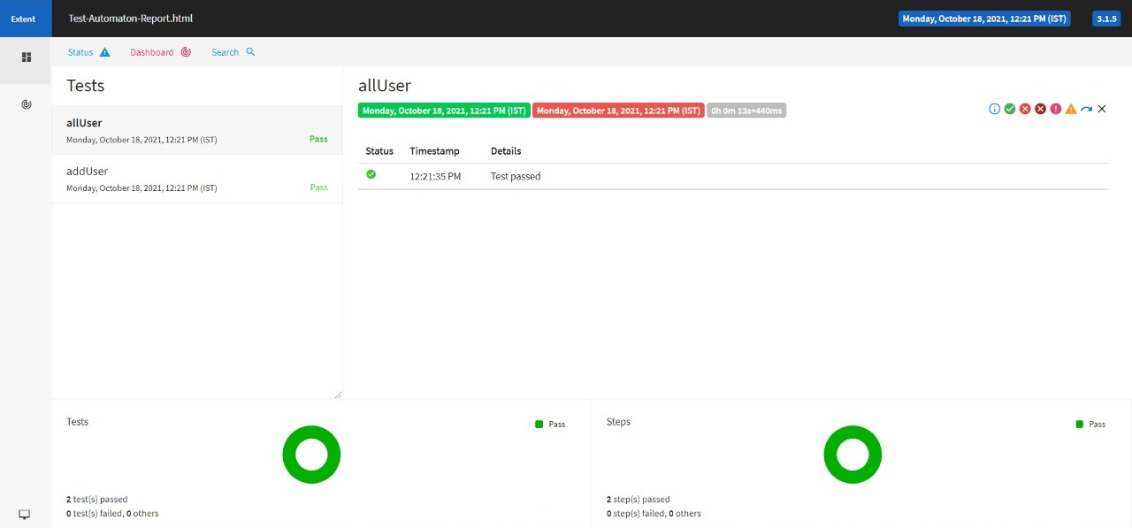
Fig. Extent Report generated

Slide 14

THANKYOU!

